Slide 1
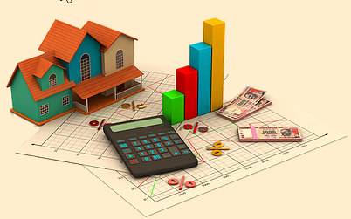
HOUSING: PRICE PREDICTION

Slide 2
INTRODUCTION
Houses are one of the necessary need of each and every person around the globe and therefore housing and real estate market is one of the markets which is one of the major contributors in the world’s economy. It is a very large market and there are various companies working in the domain. Data science comes as a very important tool to solve problems in the domain to help the companies increase their overall revenue, profits, improving their marketing strategies and focusing on changing trends in house sales and purchases. Predictive modelling, Market mix modelling, recommendation systems are some of the machine learning techniques used for achieving the business goals for housing companies. Our problem is related to one such housing company. A US-based housing company named Surprise Housing has decided to enter the Australian market. The company uses data analytics to purchase houses at a price below their actual values and flip them at a higher price. For the same purpose, the company has collected a data set from the sale of houses in Australia. The data is provided in the CSV file below. The company is looking at prospective properties to buy houses to enter the market. You are required to build a model using Machine Learning in order to predict the actual value of the prospective properties and decide whether to invest in them or not. For this company wants to know:
1.Which variables are important to predict the price of variable?
2.How do these variables describe the price of the house?

Slide 3
PROBLEM STATEMENT
We are required to model the price of houses with the available independent variables. This model will then be used by the management to understand how exactly the prices vary with the variables. They can accordingly manipulate the strategy of the firm and concentrate on areas that will yield high returns. Further, the model will be a good way for the management to understand the pricing dynamics of a new market.

Slide 4
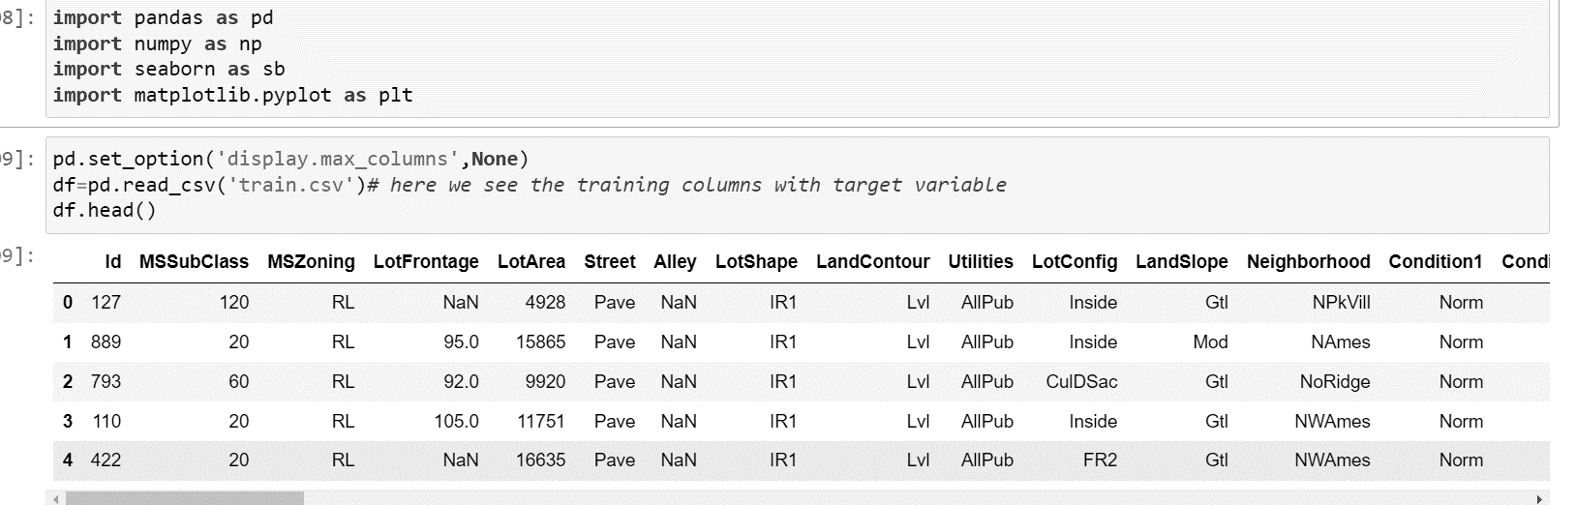
IMPORTING DATA
Important libraries are imported .
1.Pandas
2.Numpy
3.Seaborn
4.Matplotlib.pyplot
Display maximum columns as per given command.
Imported train data for now
This is just initial phase for which we see importing data and all the columns is seen in next slide

Slide 5
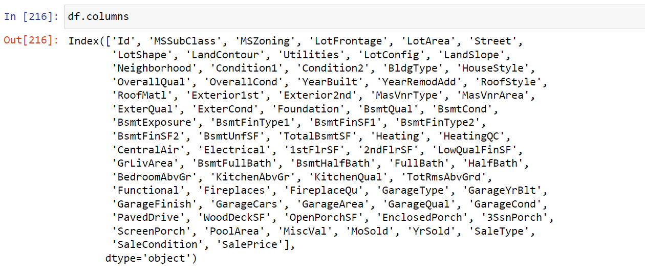
TOTAL COLUMNS IN TRAIN DATASET
These are the total columns in data set. we dropped some of irrelevant columns here
We see that it is better for prediction.

Slide 6
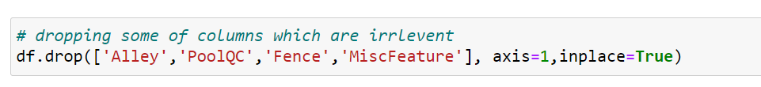
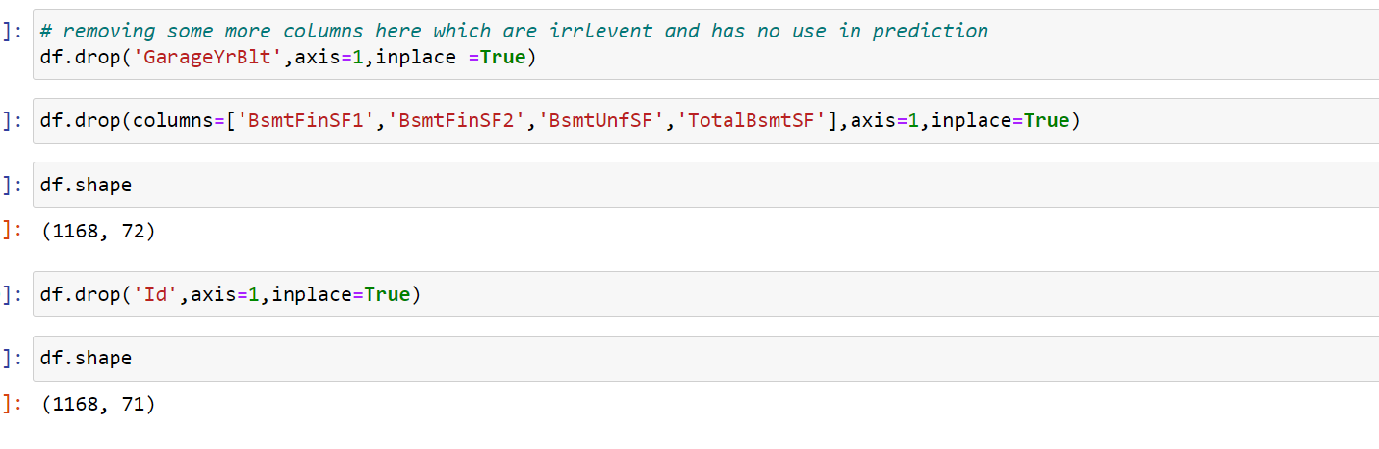
DROPPING IRRELEVANT COLUMNS
These are the columns which are dropped
From dataset .
Why these columns are dropped ?
Reasons to drop the columns is these columns
do not have any direct impact through the
price of housing .
columns are :-
Alley – It do not qualifies the parameter of
price discussion. Even if it qualifies it
contributes very less. As prediction is for
developed countries.
Pool QC:- pool quality, in practical sense
what if house has no pool.
Fence:- obviously, it is not relevant
Misc feature :- it has lots of features,
what if the basic foundation has made of valuable material
As same for BsmtFinSF1 , BsmtFinSF2 ,
BsmtUnfSF , 'TotalBsmtSF

Slide 7
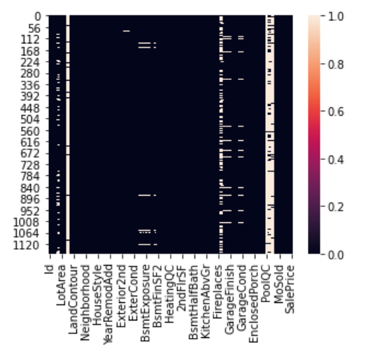
PLOTING HEATMAP TO CHECK NULL VALUES
Here the plotted figure which has light colored lines in columns shows the null values in dataset

Slide 8
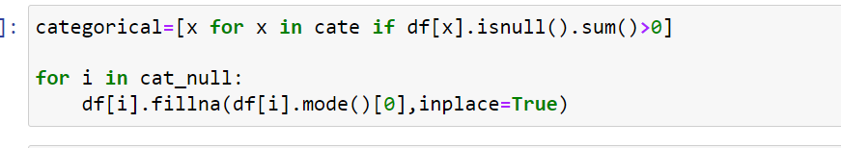
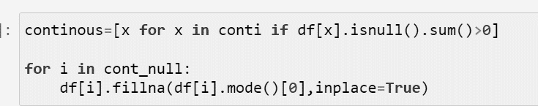
FILLING THE NULL VALUES
This is for categorical columns.
We use it for filling null values
This is continuous columns.
We use it for filling null values
For both the method I used here mode method, as per data is suitable

Slide 9
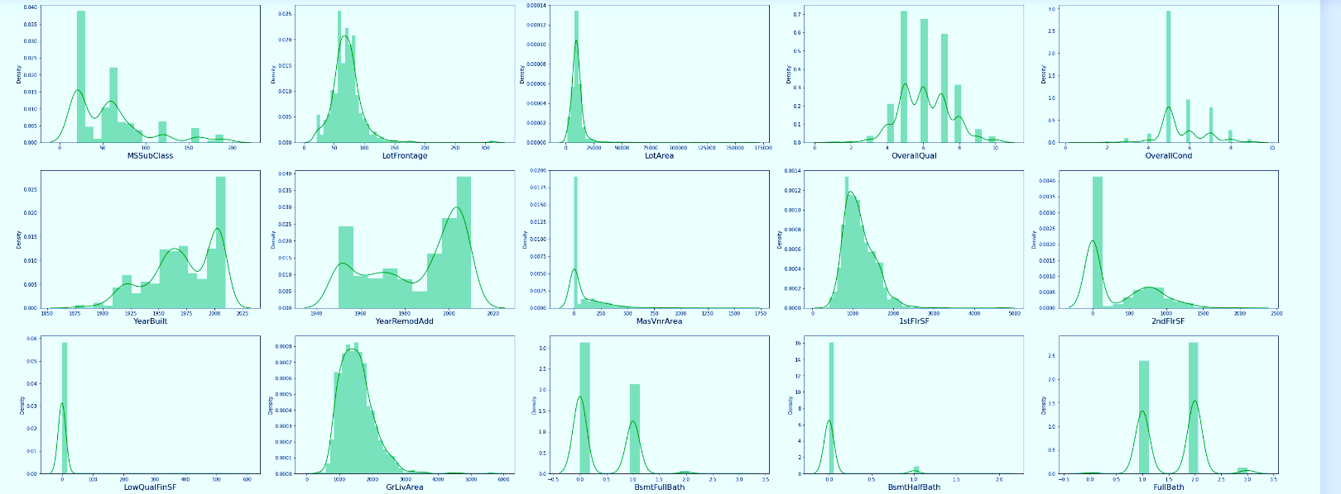
SKEWNESS OF CONTINOUS DATA
visualization is done to see
how the continuous data is
distributed.
It should be more like bell curve
If it is not then there is some skewness.
Positively skewness
Negatively skewness
We remove the skewness to make data in bell curved shape
or we say bring data in standard normal distribution
where mean = 0 and
standard deviation =1

Slide 10
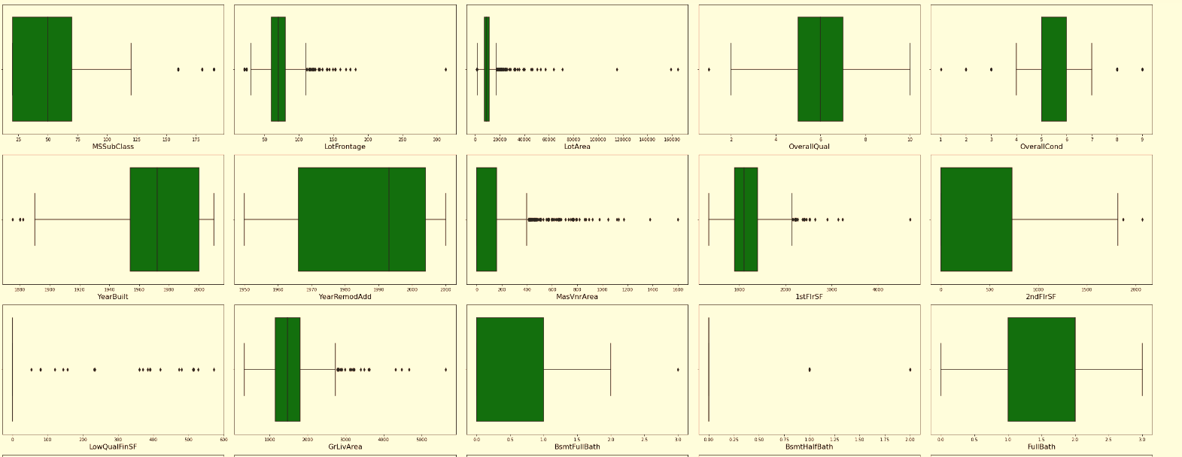
OUTLIERS FOR CONTINOUS DATA
THIS VIZULIZATION IS DONE FOR CONTINOUS DATA
HERE WE SEE THE OUTLIERS OF DATA.
WE CHECK THE OUTLIERS AND SKEWNESS ONLY FOR CONTINOUS FEATURE ,
IN THIS CASE WE SEE LOTS OF OUTLIERS WE REMOVE IT AND BRING DATA IN RELIABLE CONDITION

Slide 11
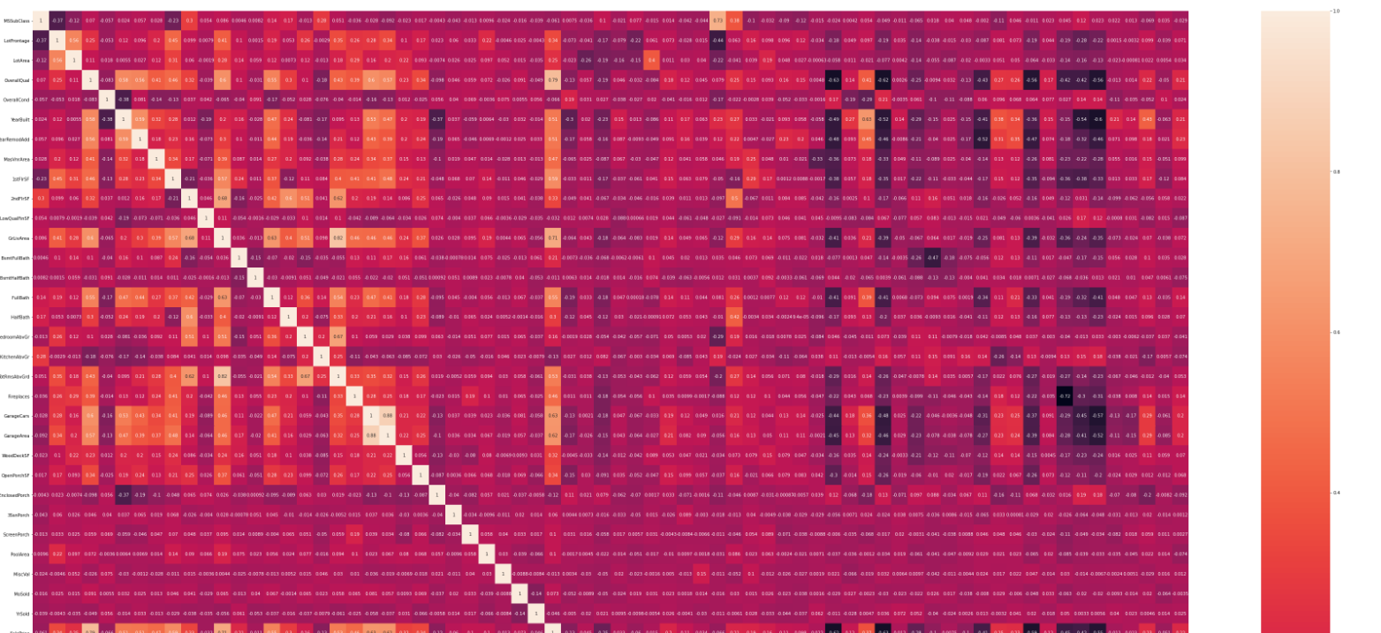
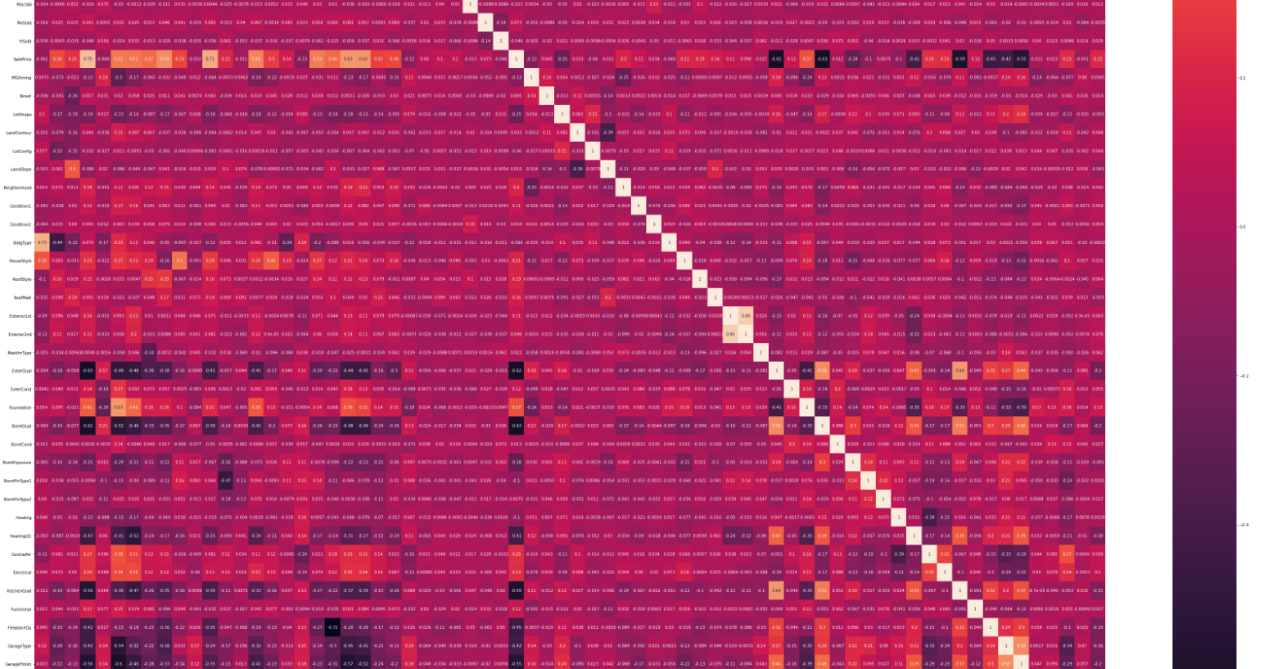
This is how correlation heatmap is when it is plotted.This is done to check weather the feature columns showing the Multicollinearity problem or not . It clear is their any multicollinearity features is present or not. If yes than how much Correlated with which feature .
For multicollinearity its threshold limit is
(>=0.90%)
It also shows the collinearity between feature and target columns.

Slide 12
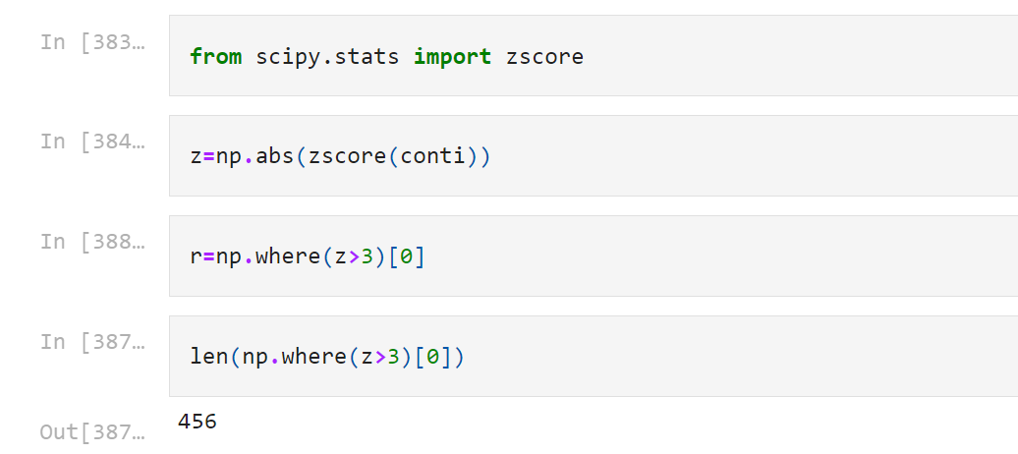
REMOVING OUTLIERS
Removing the outliers to make data
Standard normal distribution, and use
Data for prediction
Although there are different types of method
But I use here is Z score .
Which gives threshold limit z>3 above 3 all the data
Considered as outliers

Slide 13
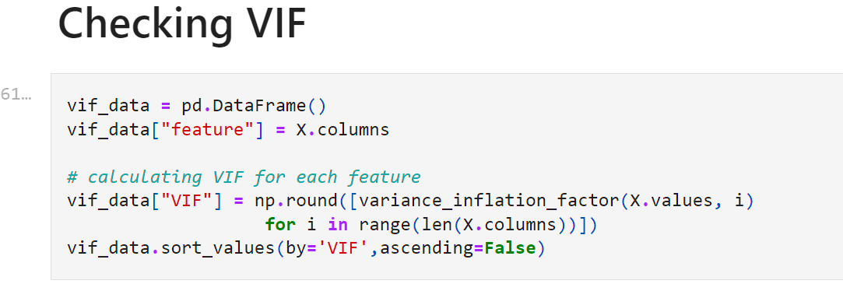
CHECKING VIF
Multicollinearity can be detected using various techniques,
One such technique being the Variance Inflation Factor(VIF).
VIF=1/ 1-R*R
Where, R-squared is the coefficient of determination in linear regression.
Its value lies between 0 and 1.

Slide 14
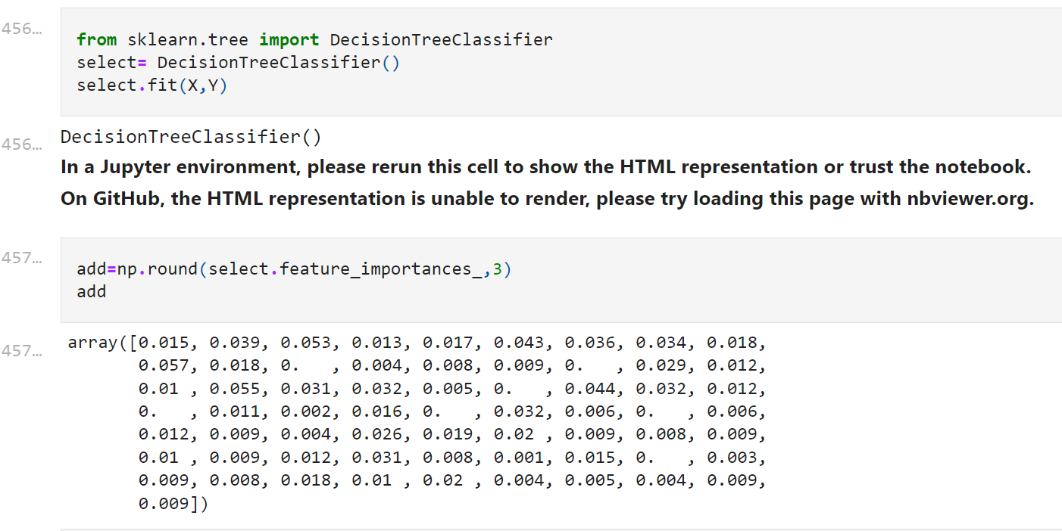
FEATURE SELECTION
Feature selection offers a simple yet effective way to overcome this challenge by eliminating redundant and irrelevant data. Removing the irrelevant data improves learning accuracy, reduces the computation time, and facilitates an enhanced understanding for the learning model or data

Slide 15
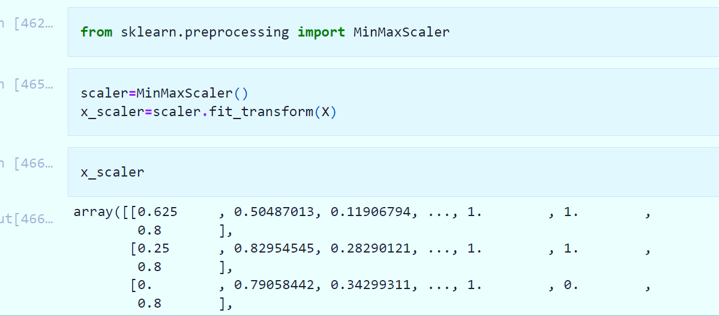
DATA SCALING
As purpose of scaling is to bring all the data into one single scale. As we see feature columns have different- different magnitude
Which through error for prediction or may
Get into biased prediction to Avoid this we use scaler
For scaling data I am using here
Min max scaler
These scaler keeps all dataset in
Between range 0 to 1

Slide 16
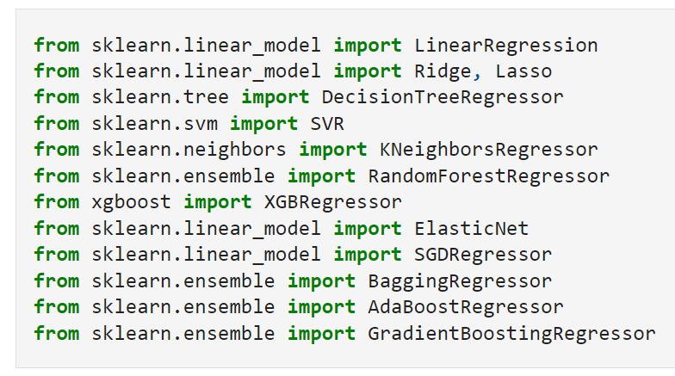
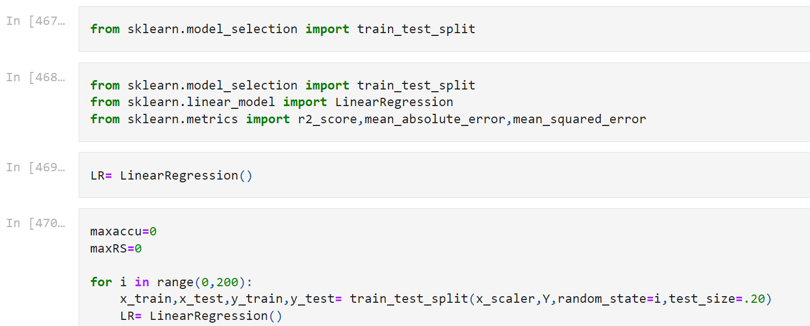
MODEL TRAINING AND BUILDING

Slide 17
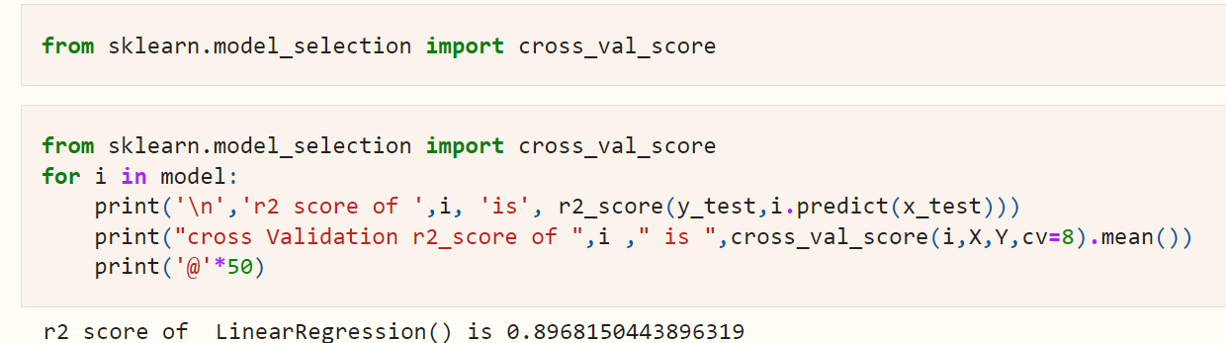
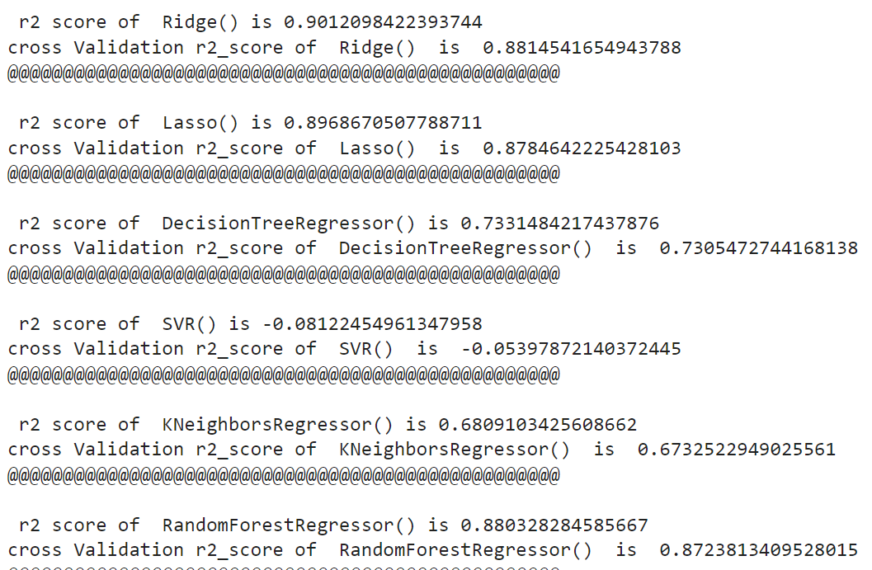
CROSS VALIDATION
Use cross-validation to detect overfitting, ie, failing to generalize a pattern
Selecting bagging regressor
as it show 86 % of accuracy
And in cross validation it
fluctuate very little as compare to any other model, so it is not over fitted.

Slide 18
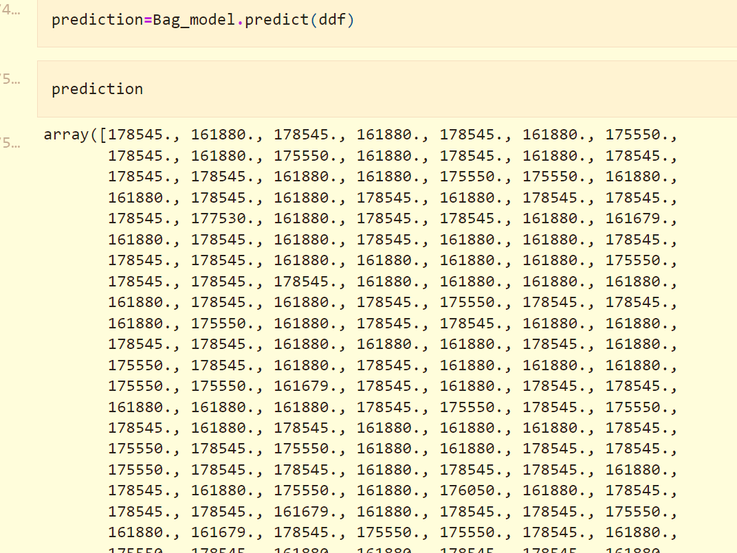
FINAL PREDICTION
This is the final prediction of model. It is used for taking further decision under the management. Saving the prediction for decision making

Slide 19
CONCLUSION
In general, the choice of a house price model and its empirical estimation is very much influenced by the quality and availability of data. While for most developed economies, sufficiently long time series of house prices and relevant fundamental variables allow error-correction or vector error-correction models to be estimated, this does not hold for a large number of Central and Eastern European Countries (CEE). Short time series, insufficient market coverage, lack of quality adjustment or distinction between old and new dwellings make forecasting much more challenging. The country size and the stage of economic development are identified as factors determining house price elasticities, with smaller countries and catching-up economies having higher responses to similar sized fundamental change than larger and more well developed economies

